Slide 1
Case Study: ExoPlayer
Parinya Ekparinya
Parinya.Ek@kmitl.ac.th
Software Architecture and Design

Slide 2
Outline
What is ExoPlayer
Architecture
Quality Attributes
Design Pattern 1
Design Pattern 2
Design Pattern 3
Design Pattern 4

Slide 3
What is ExoPlayer
ExoPlayer is an application level media player for Android.
It provides an alternative to Android’s MediaPlayer API for playing audio and video both locally and over the Internet.
ExoPlayer supports features not currently supported by Android’s MediaPlayer API, including DASH and SmoothStreaming adaptive playbacks.
ExoPlayer is easy to customize and extend, and can be updated through Play Store application updates.
Source: https://exoplayer.dev/

Slide 4
ExoPlayer: Architecture

Slide 5
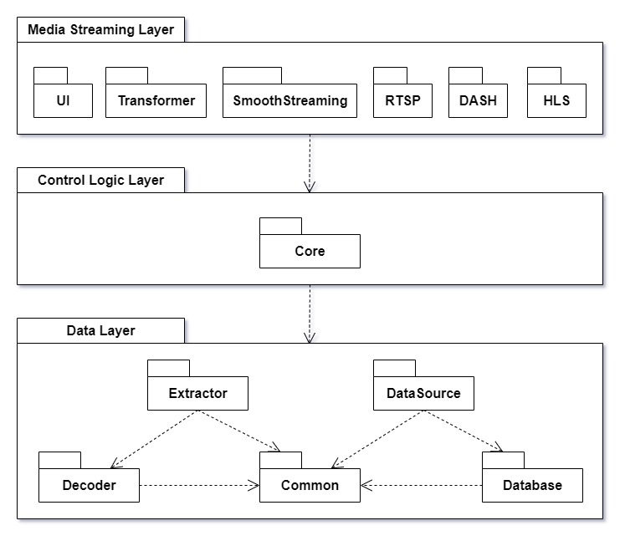

Slide 6
How to find the needed information ??

Slide 7
Quality Attributes
Interoperability
“Support for DASH and SmoothStreaming. Many other formats are also supported.”
Modifiability
“The ability to customize and extend the player to suit your use case.”
Usability
“Support for playlists.”
Weakness: Performance
“For audio only playback on some devices, ExoPlayer may consume significantly more battery than MediaPlayer.”
Source: https://exoplayer.dev/pros-and-cons.html

Slide 8
ExoPlayer: Design Patterns

Slide 9
Builder Pattern
https://github.com/google/ExoPlayer/blob/r2.17.1/testutils/src/main/java/com/google/android/exoplayer2/testutil/DownloadBuilder.java
DownloadBuilder acts as a builder
Line 109 to 197: methods for setting various parameters and returning the object itself (this)
Line 199 to 217: build method returns an instance of Download
Usage:
https://github.com/google/ExoPlayer/blob/r2.17.1/library/core/src/test/java/com/google/android/exoplayer2/offline/DefaultDownloadIndexTest.java
instantiate instances of Download with defined internal states (attributes) for testing.

Slide 10

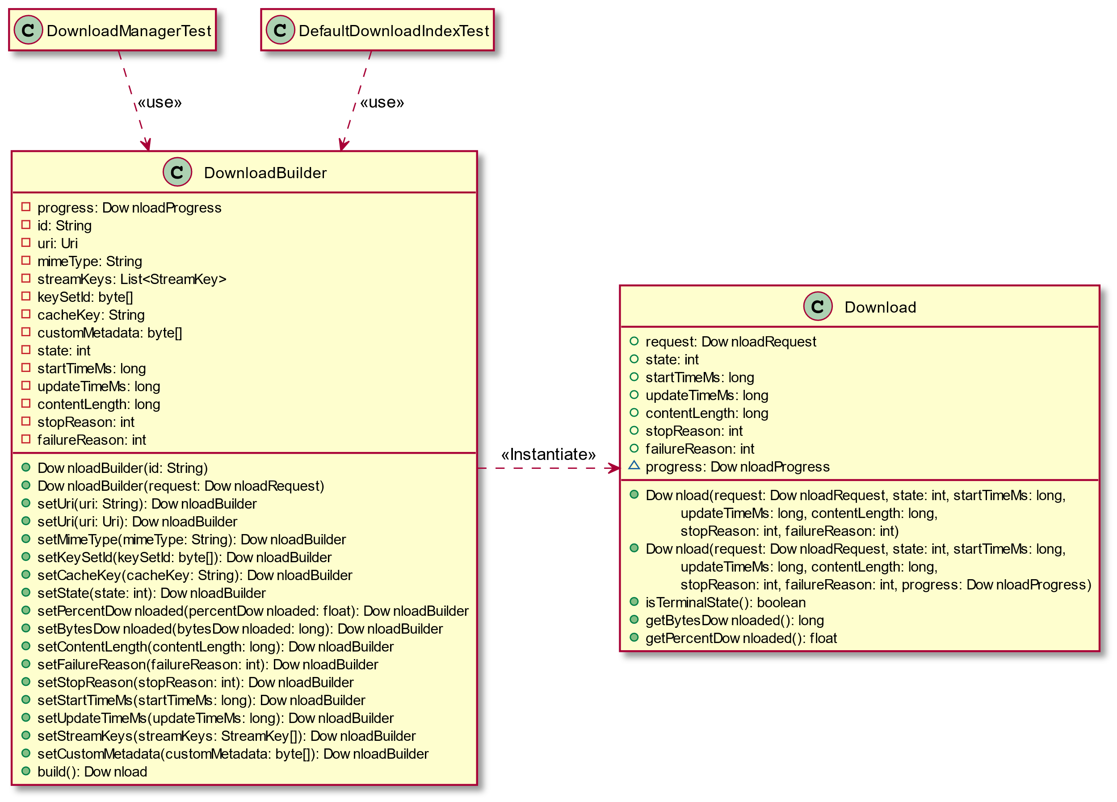

Slide 11
Composite Pattern
https://github.com/google/ExoPlayer/blob/r2.17.1/library/core/src/main/java/com/google/android/exoplayer2/source/CompositeSequenceableLoader.java
CompositeSequenceableLoader applies composite pattern
Line 23: CompositeSequenceableLoader realizes SequenceableLoader interface
Line 25: declare an array of SequenceableLoader
Usage:
https://github.com/google/ExoPlayer/blob/r2.17.1/library/core/src/main/java/com/google/android/exoplayer2/source/DefaultCompositeSequenceableLoaderFactory.java
to store various SequenceableLoader objects (subtypes of MediaPeriod)

Slide 12
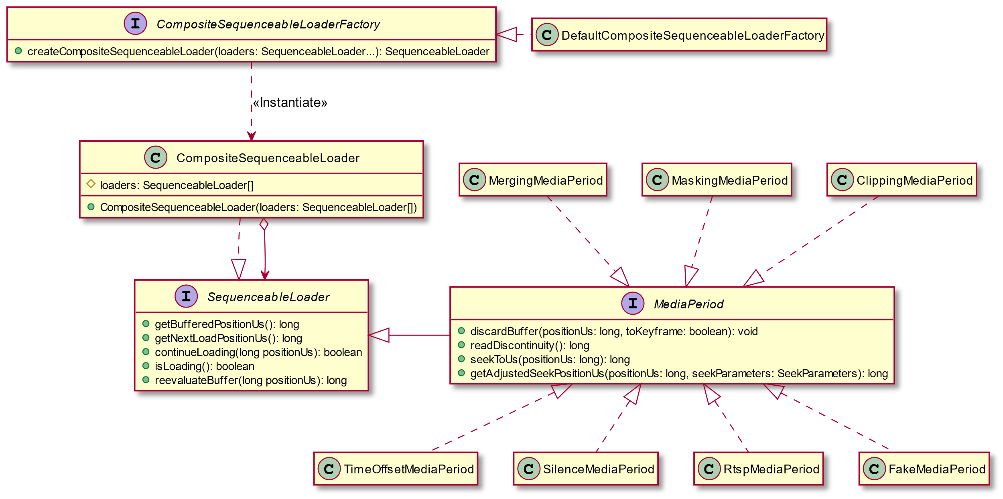

Slide 13
Singleton Pattern
https://github.com/google/ExoPlayer/blob/r2.17.1/library/common/src/main/java/com/google/android/exoplayer2/util/NetworkTypeObserver.java
NetworkTypeObserver applies singleton pattern
Line 94 to 99: public static getInstance method
Line 107: Constructor is private
Usage:
https://github.com/google/ExoPlayer/blob/r2.17.1/library/core/src/main/java/com/google/android/exoplayer2/upstream/DefaultBandwidthMeter.java
to limit the number of network type change listener to one instance for bandwidth metering

Slide 14
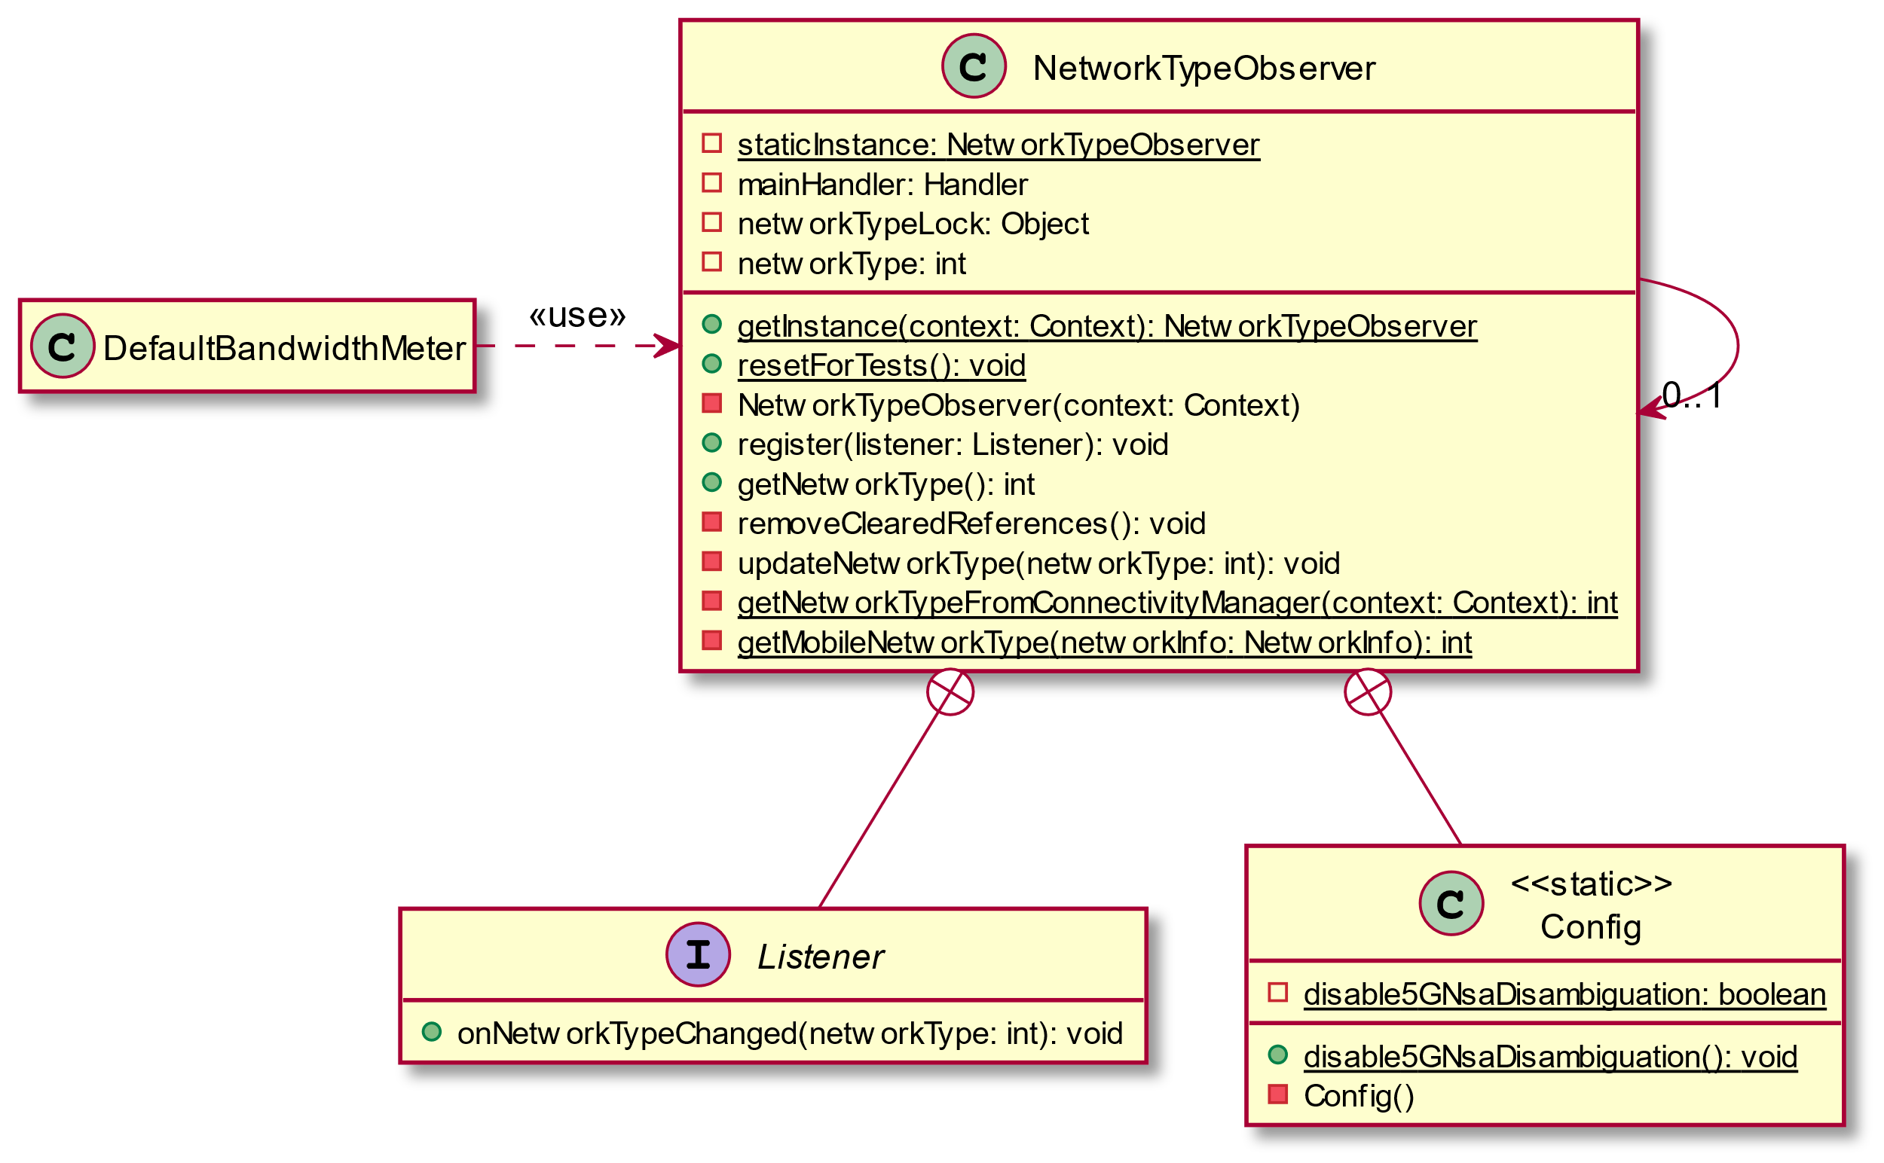

Slide 15
Proxy Pattern
https://github.com/google/ExoPlayer/blob/r2.17.1/library/common/src/main/java/com/google/android/exoplayer2/util/SystemHandlerWrapper.java
SystemHandler acts as a proxy
Line 27 to 168: each method make a call on its wrapped object with the same method name
Usage:
https://github.com/google/ExoPlayer/blob/r2.17.1/library/common/src/main/java/com/google/android/exoplayer2/util/SystemClock.java
to limit the pool size of SystemMessage

Slide 16
